Slide 1
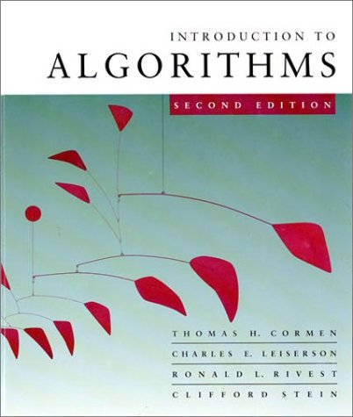
Introduction to Algorithms
6.046J/18.401J
LECTURE 4
Quicksort
Divide and conquer
Partitioning
Worst-case analysis
Intuition
Randomized quicksort
Analysis
Prof. Charles E. Leiserson

Slide 2
Quicksort
Proposed by C.A.R. Hoare in 1962.
Divide-and-conquer algorithm.
Sorts “in place” (like insertion sort, but not like merge sort).
Very practical (with tuning).

Slide 3
Divide and conquer
Quicksort an n-element array:
Divide: Partition the array into two subarrays around a pivot x such that elements in lower subarray ≤ x ≤ elements in upper subarray.
Conquer: Recursively sort the two subarrays.
Combine: Trivial.
≤ x
x
≥ x
Key: Linear-time partitioning subroutine.

Slide 4
Partitioning subroutine
PARTITION(A, p, q) ⊳ A[ p . . q]
  x ← A[ p] ⊳ pivot = A[ p]
  i ← p
  for j ← p + 1 to q
    do if A[ j] ≤ x
        then i ← i + 1
        exchange A[i] ↔ A[ j]
  exchange A[ p] ↔ A[i]
  return i
Running time = O(n) for n elements.
Invariant:
x
≤ x
≥ x
?
p
i
j
q

Slide 5
Example of partitioning
6
10
13
5
8
3
2
11
i
j

Slide 6
Example of partitioning
6
10
13
5
8
3
2
11
i
j

Slide 7
Example of partitioning
6
10
13
5
8
3
2
11
i
j

Slide 8
Example of partitioning
6
10
13
5
8
3
2
11
6
5
13
10
8
3
2
11
i
j

Slide 9
Example of partitioning
6
10
13
5
8
3
2
11
6
5
13
10
8
3
2
11
i
j

Slide 10
Example of partitioning
6
10
13
5
8
3
2
11
6
5
13
10
8
3
2
11
i
j

Slide 11
Example of partitioning
6
10
13
5
8
3
2
11
6
5
13
10
8
3
2
11
6
5
3
10
8
13
2
11
i
j

Slide 12
Example of partitioning
6
10
13
5
8
3
2
11
6
5
13
10
8
3
2
11
6
5
3
10
8
13
2
11
i
j

Slide 13
Example of partitioning
6
10
13
5
8
3
2
11
6
5
13
10
8
3
2
11
6
5
3
10
8
13
2
11
6
5
3
2
8
13
10
11
i
j

Slide 14
Example of partitioning
6
10
13
5
8
3
2
11
6
5
13
10
8
3
2
11
6
5
3
10
8
13
2
11
6
5
3
2
8
13
10
11
i
j

Slide 15
Example of partitioning
6
10
13
5
8
3
2
11
6
5
13
10
8
3
2
11
6
5
3
10
8
13
2
11
6
5
3
2
8
13
10
11
i
j

Slide 16
Example of partitioning
6
10
13
5
8
3
2
11
6
5
13
10
8
3
2
11
6
5
3
10
8
13
2
11
6
5
3
2
8
13
10
11
2
5
3
6
8
13
10
11
i

Slide 17
Pseudocode for quicksort
QUICKSORT(A, p, r)
  if p < r
    then q ← PARTITION(A, p, r) QUICKSORT(A, p, q–1)
      QUICKSORT(A, q+1, r)
Initial call: QUICKSORT(A, 1, n)

Slide 18
Analysis of quicksort
Assume all input elements are distinct.
In practice, there are better partitioning algorithms for when duplicate input elements may exist.
Let T(n) = worst-case running time on an array of n elements.

Slide 19
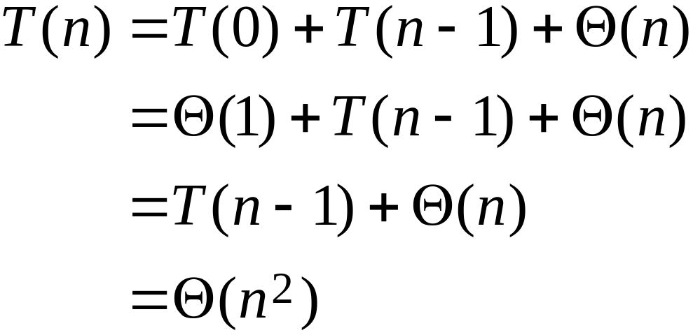
Worst-case of quicksort
Input sorted or reverse sorted.
Partition around min or max element.
One side of partition always has no elements.
(arithmetic series)

Slide 20
Worst-case recursion tree
T(n) = T(0) + T(n–1) + cn

Slide 21
Worst-case recursion tree
T(n) = T(0) + T(n–1) + cn
T(n)

Slide 22
Worst-case recursion tree
T(n) = T(0) + T(n–1) + cn
cn
T(0)
T(n–1)

Slide 23
Worst-case recursion tree
T(n) = T(0) + T(n–1) + cn
cn
T(0)
c(n–1)
T(0)
T(n–2)

Slide 24

Worst-case recursion tree
T(n) = T(0) + T(n–1) + cn
cn
T(0)
c(n–1)
T(0)
c(n–2)
T(0)
Θ(1)

Slide 25
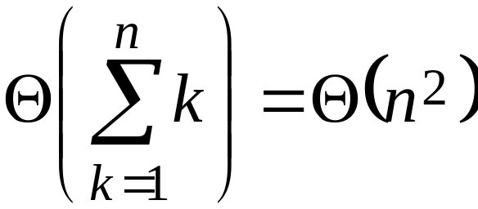
Worst-case recursion tree
T(n) = T(0) + T(n–1) + cn
cn
T(0)
c(n–1)
T(0)
c(n–2)
T(0)
Θ(1)

Slide 26
Worst-case recursion tree
T(n) = T(0) + T(n–1) + cn
cn
Θ(1)
c(n–1)
Θ(1)
c(n–2)
h = n
T(n) = Θ(n) + Θ(n²)
= Θ(n²)
Θ(1)
Θ(1)

Slide 27
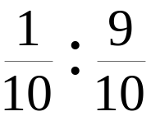
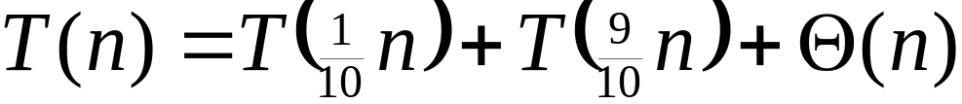
Best-case analysis
(For intuition only!)
If we’re lucky, PARTITION splits the array evenly:
T(n) = 2T(n/2) + Θ(n)
= Θ(n lg n)
(same as merge sort)
What if the split is always
?
What is the solution to this recurrence?

Slide 28

Analysis of “almost-best” case

Slide 29

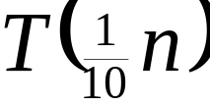
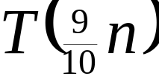
Analysis of “almost-best” case

Slide 30
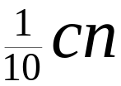
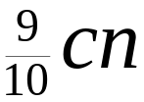
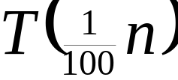
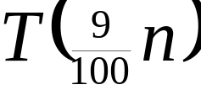
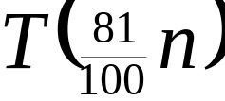
Analysis of “almost-best” case

Slide 31
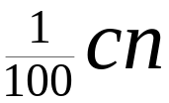
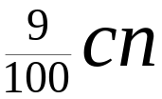
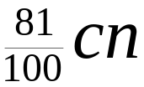
Analysis of “almost-best” case
log_{10/9}n
…
…
O(n) leaves
…
Θ(1)
Θ(1)

Slide 32
Analysis of “almost-best” case
log₁₀n
log_{10/9}n
…
…
O(n) leaves
…
Θ(1)
Θ(n lg n)
Lucky!
Θ(1)
cn log₁₀n ≤
T(n) ≤ cn log_{10/9}n + Ο(n)

Slide 33
More intuition
Suppose we alternate lucky, unlucky, lucky, unlucky, lucky, ….
  L(n) = 2U(n/2) + Θ(n) lucky
  U(n) = L(n – 1) + Θ(n) unlucky
Solving:
  L(n) = 2(L(n/2 – 1) + Θ(n/2)) + Θ(n)
  = 2L(n/2 – 1) + Θ(n)
  = Θ(n lg n)
Lucky!
How can we make sure we are usually lucky?

Slide 34
Randomized quicksort
IDEA: Partition around a random element.
Running time is independent of the input order.
No assumptions need to be made about the input distribution.
No specific input elicits the worst-case behavior.
The worst case is determined only by the output of a random-number generator.

Slide 35
Randomized quicksort analysis
Let T(n) = the random variable for the running time of randomized quicksort on an input of size n, assuming random numbers are independent.
For k = 0, 1, …, n–1, define the indicator random variable
1 if PARTITION generates a k : n–k–1 split,
0 otherwise.
X_{k} =
E[X_{k}] = Pr{X_{k} = 1} = 1/n, since all splits are equally likely, assuming elements are distinct.

Slide 36
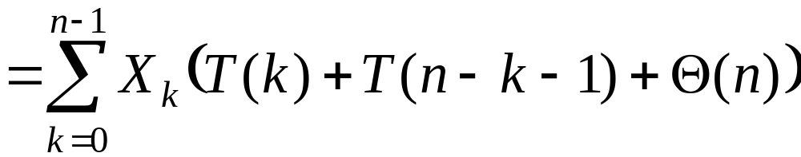
Analysis (continued)
T(0) + T(n–1) + Θ(n) if 0 : n–1 split,
T(1) + T(n–2) + Θ(n) if 1 : n–2 split,

T(n–1) + T(0) + Θ(n) if n–1 : 0 split,
T(n) =

Slide 37
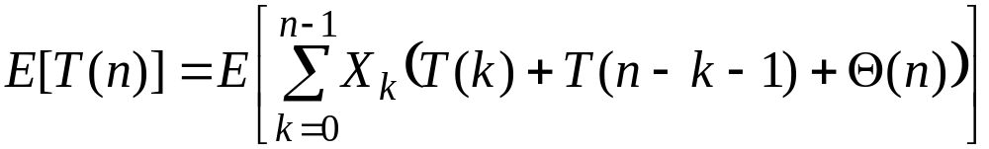
Calculating expectation
Take expectations of both sides.

Slide 38
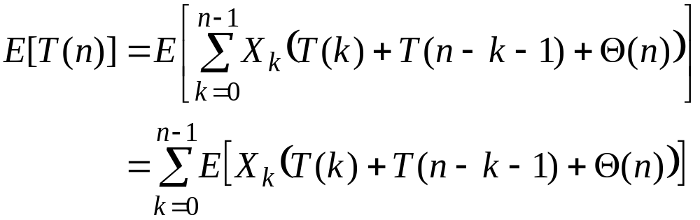
Calculating expectation
Linearity of expectation.

Slide 39
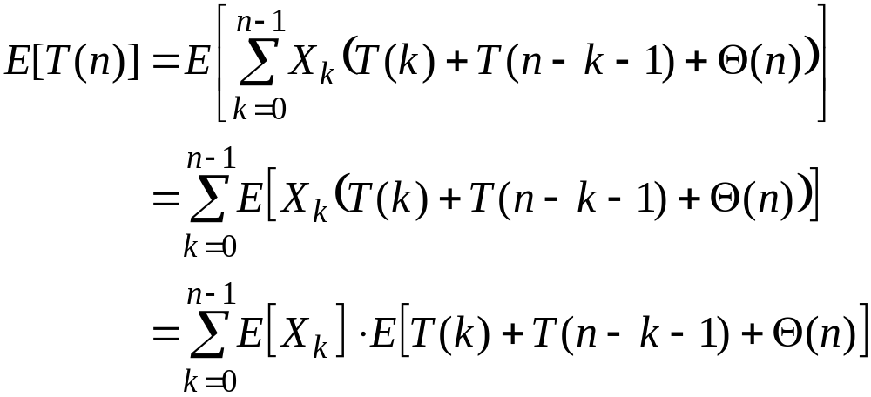
Calculating expectation
Independence of X_{k} from other random choices.

Slide 40
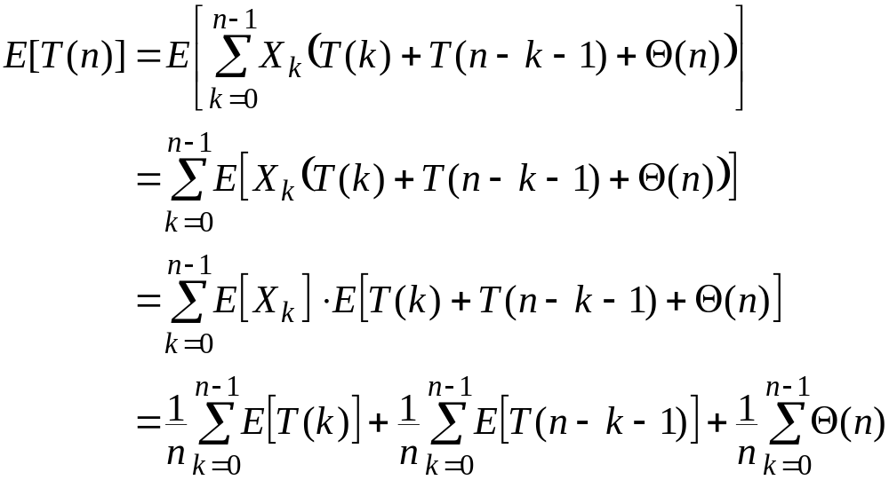
Calculating expectation
Linearity of expectation; E[X_{k}] = 1/n .

Slide 41
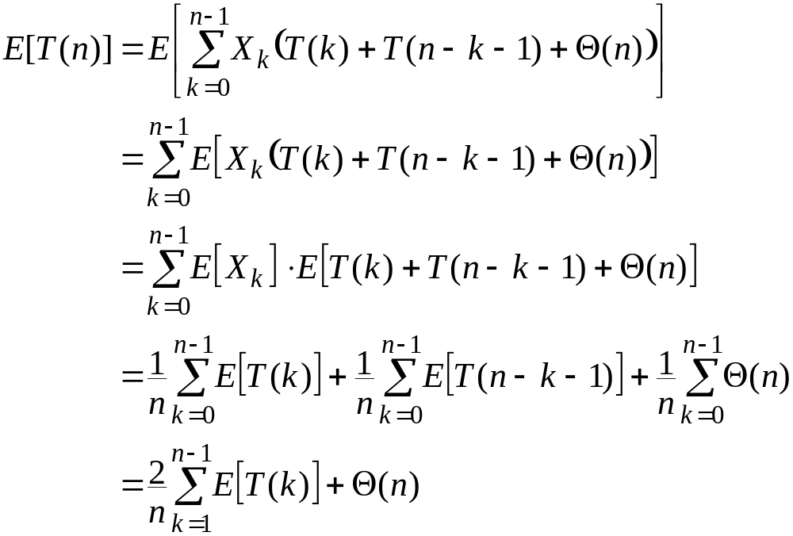
Calculating expectation
Summations have identical terms.

Slide 42
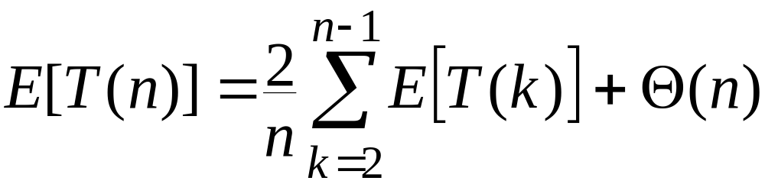
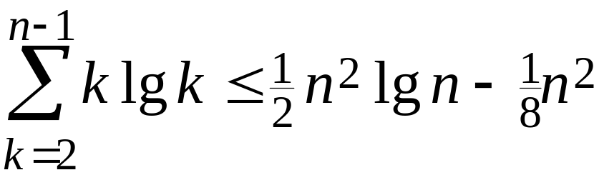
Hairy recurrence
(The k = 0, 1 terms can be absorbed in the Θ(n).)
Prove: E[T(n)] ≤ a n lg n for constant a > 0 .
Choose a large enough so that a n lg n dominates E[T(n)] for sufficiently small n ≥ 2.
Use fact:
(exercise).

Slide 43
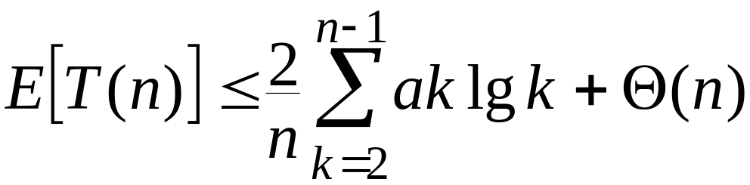
Substitution method
Substitute inductive hypothesis.

Slide 44
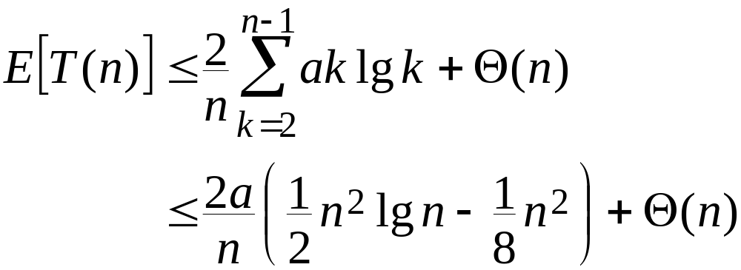
Substitution method
Use fact.

Slide 45
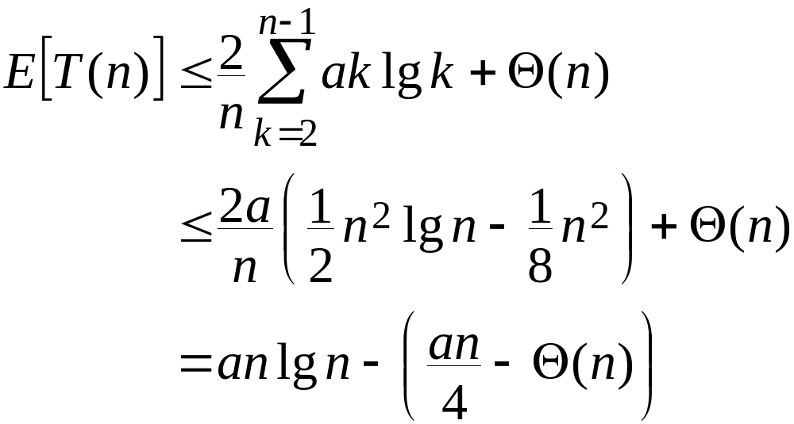
Substitution method
Express as desired – residual.

Slide 46
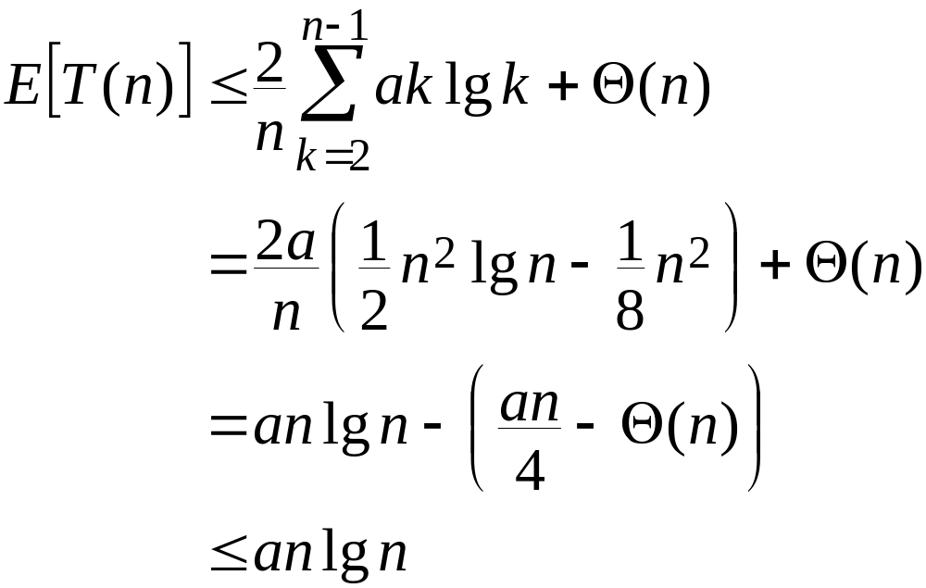
Substitution method
,
if a is chosen large enough so that an/4 dominates the Θ(n).

Slide 47
Quicksort in practice
Quicksort is a great general-purpose sorting algorithm.
Quicksort is typically over twice as fast as merge sort.
Quicksort can benefit substantially from code tuning.
Quicksort behaves well even with caching and virtual memory.

